Slide 1
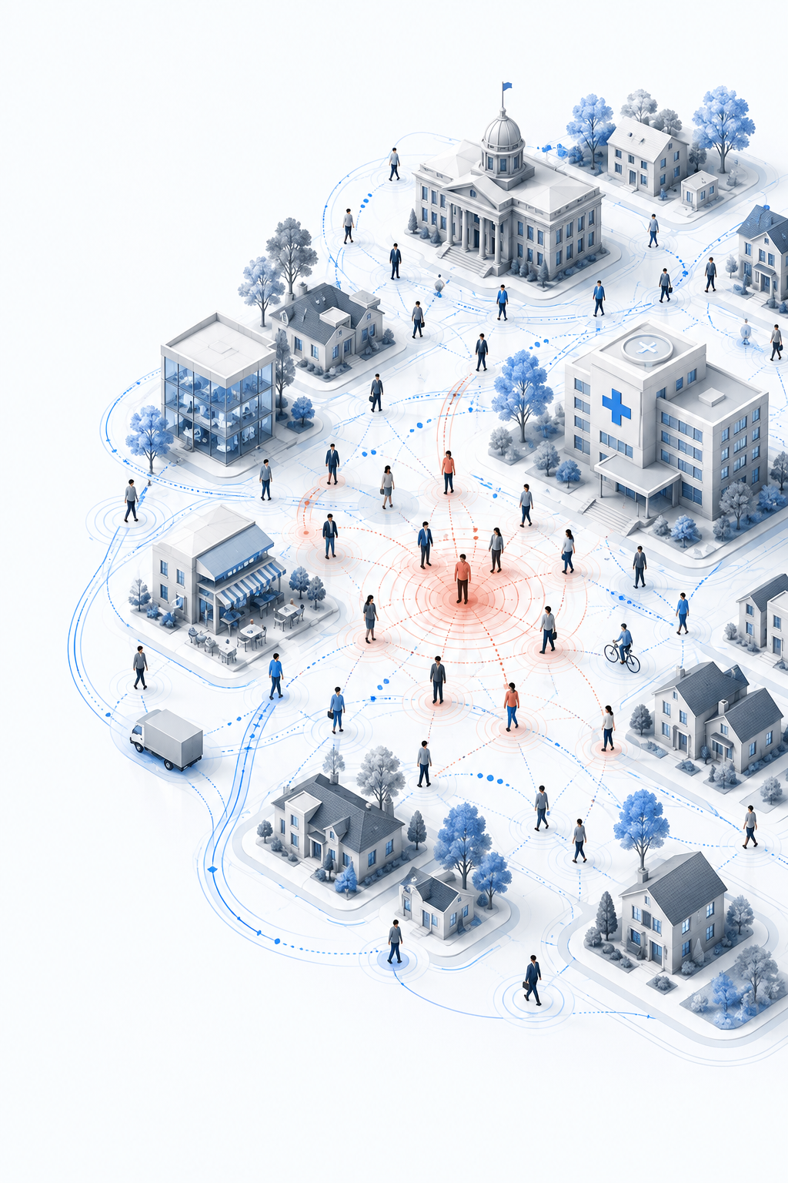
AGENT-BASED MODELLING · COMPLEX SYSTEMS
COVID-ABS: An agent-based model of COVID-19 epidemic to simulate health and economic effects of social distancing interventions
Based on Silva et al. (2020)
Presented by:
IM/2021/108 - Miyulakshi Gunawardhana
IM/2021/097 - Gayan Nagasinghe

Slide 2
Which COVID policy would you choose?
Imagine COVID is spreading in your country. Hospitals have limited capacity, but restrictions also affect businesses and the economy.
Which policy would you choose?
A
B
C
Protect only
high-risk groups
Full
lockdown
Masks +
50% isolation
Keep your answer. We will compare it with the model results.
02

Slide 3

ABM builds the big picture from small actions
Agent Based Modelling is a computer simulation where individual agents follow simple rules.
1
Define agents
2
Give local rules
3
Run many times
People, houses, firms, government and hospitals
Move, meet, become infected, work, spend and pay tax
Observe patterns that were not written directly
MICRO
One agent
uses simple rules
MACRO
Epidemic and economic patterns
× many agents + time + chance
This bottom-up result is called emergence.
03

Slide 4
Why COVID is a complex system
Different agents
Local interaction
Emergence
Age, health, income and movement are not the same.
Infection happens through close contact in nearby people.
The pandemic emerges from thousands of individual interactions rather than one central controller.
Non-linearity
Feedback
Path + chance
A small rule change can create a large system change.
More cases create more hospital cost and policy response, which then affects people's behaviour.
Early random contacts change later outcomes.
Adaptation is limited: agents change state, but they do not learn new behaviour.
04

Slide 5
Research Design
Main question
Virtual world
How do social-distancing policies change both health and economic outcomes?
300 people
500 × 500 space
1 hour per step
60 days
35 runs for each scenario
Why ABM instead of only an average equation model?
Who meets whom matters. People have different homes, jobs, ages and wealth.
Where and when matters. Contact changes with work, leisure and isolation.
Policy changes rules. The model can directly change movement and contact probability.
All these are difficult to represent using only traditional mathematical equations.
ABM allows researchers to compare different policies before applying them in the real world.
05

Slide 6
AGENT ARCHITECTURE
Five agent types create one connected society
A2 · House
A3 · Business
Family, shared money and household expenses
Work, salary, sales, tax and operating cost
A1
PERSON
A4 · Government
A5 · Health care
Tax, public aid and health-system funding
Hospital capacity, treatment and health cost
Person state: age · position · home · job · infection · severity · wealth
06

Slide 7
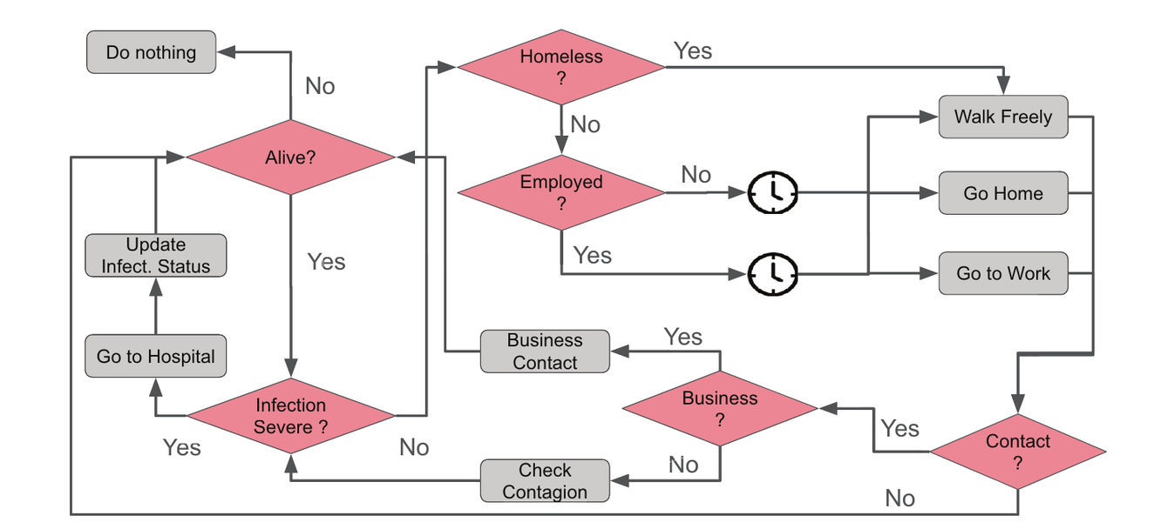
BEHAVIOURAL MODEL
A person follows simple hour-by-hour rules
Example if–then rules
If 00:00–08:00, go home.
If working hours, employed people go to work.
If severe infection, go to hospital.
If distance ≤ 1 unit, contact occurs.
If contact occurs, infection succeeds with probability 0.9.
07

Slide 8
POLICY EXPERIMENT
Seven scenarios change the rules-not the people
#
Scenario
What rule changes?
1
Do nothing
Normal movement
2
Lockdown
People stay home
3
Conditional lockdown
Turns on/off at 5% infection
4
Vertical isolation
Young, old and symptomatic isolate
5
50% isolation
A random half stays home
6
Masks + distance
Lower contact distance and infection chance
7
Masks + 50% isolation
Combine scenarios 5 and 6
Audience prediction: which scenario gives the best health–economy balance?
08

Slide 9
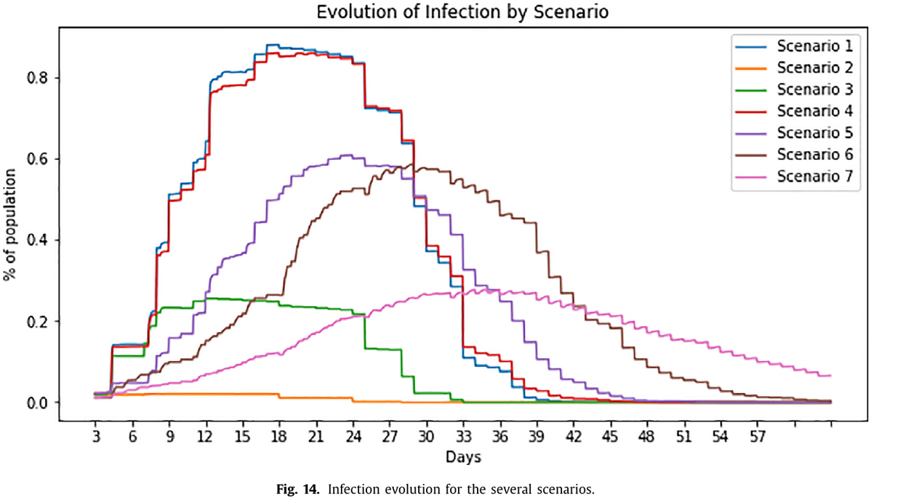
EMERGENCE AND RESULTS
The results show a difficult trade-off
Best health result
2 Lockdown · 3 Conditional lockdown
Weak result
4 Vertical isolation ≈ 1 Do nothing
Best practical compromise
7 Masks + 50% isolation
09

Slide 10
VALIDATION AND LIMITATIONS
Useful for scenarios-but not an exact forecast
What the paper did well
What is still weak
Evidence-based inputs for Brazilian population, income, work and clinical rates.
Some calibration against a SEIR calculator.
35 stochastic runs to show average behaviour and variation.
Comparison with patterns from earlier studies.
No direct historical fit to Brazilian case and death time series.
No independent holdout test in another time or place.
Small closed world with only 300 people and random locations.
Fixed behaviour and no firing or firm closure.
10

Slide 11
INTERACTIVE BRIDGE
One student has two choices. Is that already complex?
STUDENT
Choice A
Choice B
Prepare and answer honestly
Make an unauthorized attempt to obtain answers
Answer: one decision is not enough. Complexity appears when many people interact over time.
11

Slide 12
PRACTICAL APPLICATION
Academic integrity becomes a complex system
Friends / peers
Teacher
Honest or dishonest behaviour changes what feels normal
Teaching quality, feedback, deadlines and fair assessment
STUDENT
Exam system
Support services
Monitoring, rules, detection and consequences
Tutoring, counselling, study skills and early help
12

Slide 13
MODEL DESIGN
Proposed ABM: agents, states, rules and outputs
Part
Example design
Why it matters
Agents
Students, peer groups, teachers, exam unit, support services
Different actors have different goals and information
Student state
Preparation, knowledge, stress, ethics, pressure, perceived risk
The same exam can produce different decisions
Environment
Class, friend network, online learning space, exam setting
Influence is local-not every student meets everyone
Actions
Study, ask for help, share norms, answer honestly, unauthorized attempt
Actions change both self and peers
Outputs
Honest rate, attempts, detections, marks, stress, trust, cost
Policies can have benefits and side effects
This is our proposed application-not a model from the COVID-ABS paper.
13

Slide 14
RULES AND FEEDBACK
The decision is probabilistic-not automatic
Pressures that increase temptation
Protection that supports honesty
+ Low preparation
+ Ethical commitment
Student decision
+ High stress
+ Academic support
P(unauthorized attempt)
changes with the student's
current state and context
+ Peer cheating
+ Fair monitoring
+ High opportunity
+ High perceived risk
Feedback loop 1
A peer succeeds → perceived risk may fall → more attempts may emerge
Feedback loop 2
Early support → preparation rises → stress falls → honest work may increase
The weights must be estimated from evidence; they should not be guessed.
14

Slide 15
INTERACTIVE EXPERIMENT
Which policy would improve integrity most?
1
Baseline
2
Strict monitoring
3
Academic support
Current teaching, support and monitoring
Opportunity ↓ · perceived risk ↑
Preparation ↑ · stress ↓
4
Counselling
5
Peer mentoring
6
Combined policy
Stress and pressure ↓
Honest norm and ethics ↑
Support + fair monitoring + counselling
Best policy is not only ‘fewest attempts’: also check learning, stress, fairness, trust and cost.
15

Slide 16
VALIDATION PLAN
A useful model needs evidence and privacy protection
1
2
3
4
Collect
Calibrate
Validate
Stress-test
Anonymous surveys
Past misconduct counts
Marks and attendance
Estimate stress, peer and risk effects from earlier semesters
Test on a later semester or a different programme
Change assumptions and show uncertainty
Ethical rules
Use anonymous and aggregated data. Do not label an individual as a likely cheater.
Model prevention, not breach methods. Keep unauthorized action as an abstract state.
Check fairness. Compare effects across groups and report bias or uncertainty.
16

